Slide 1
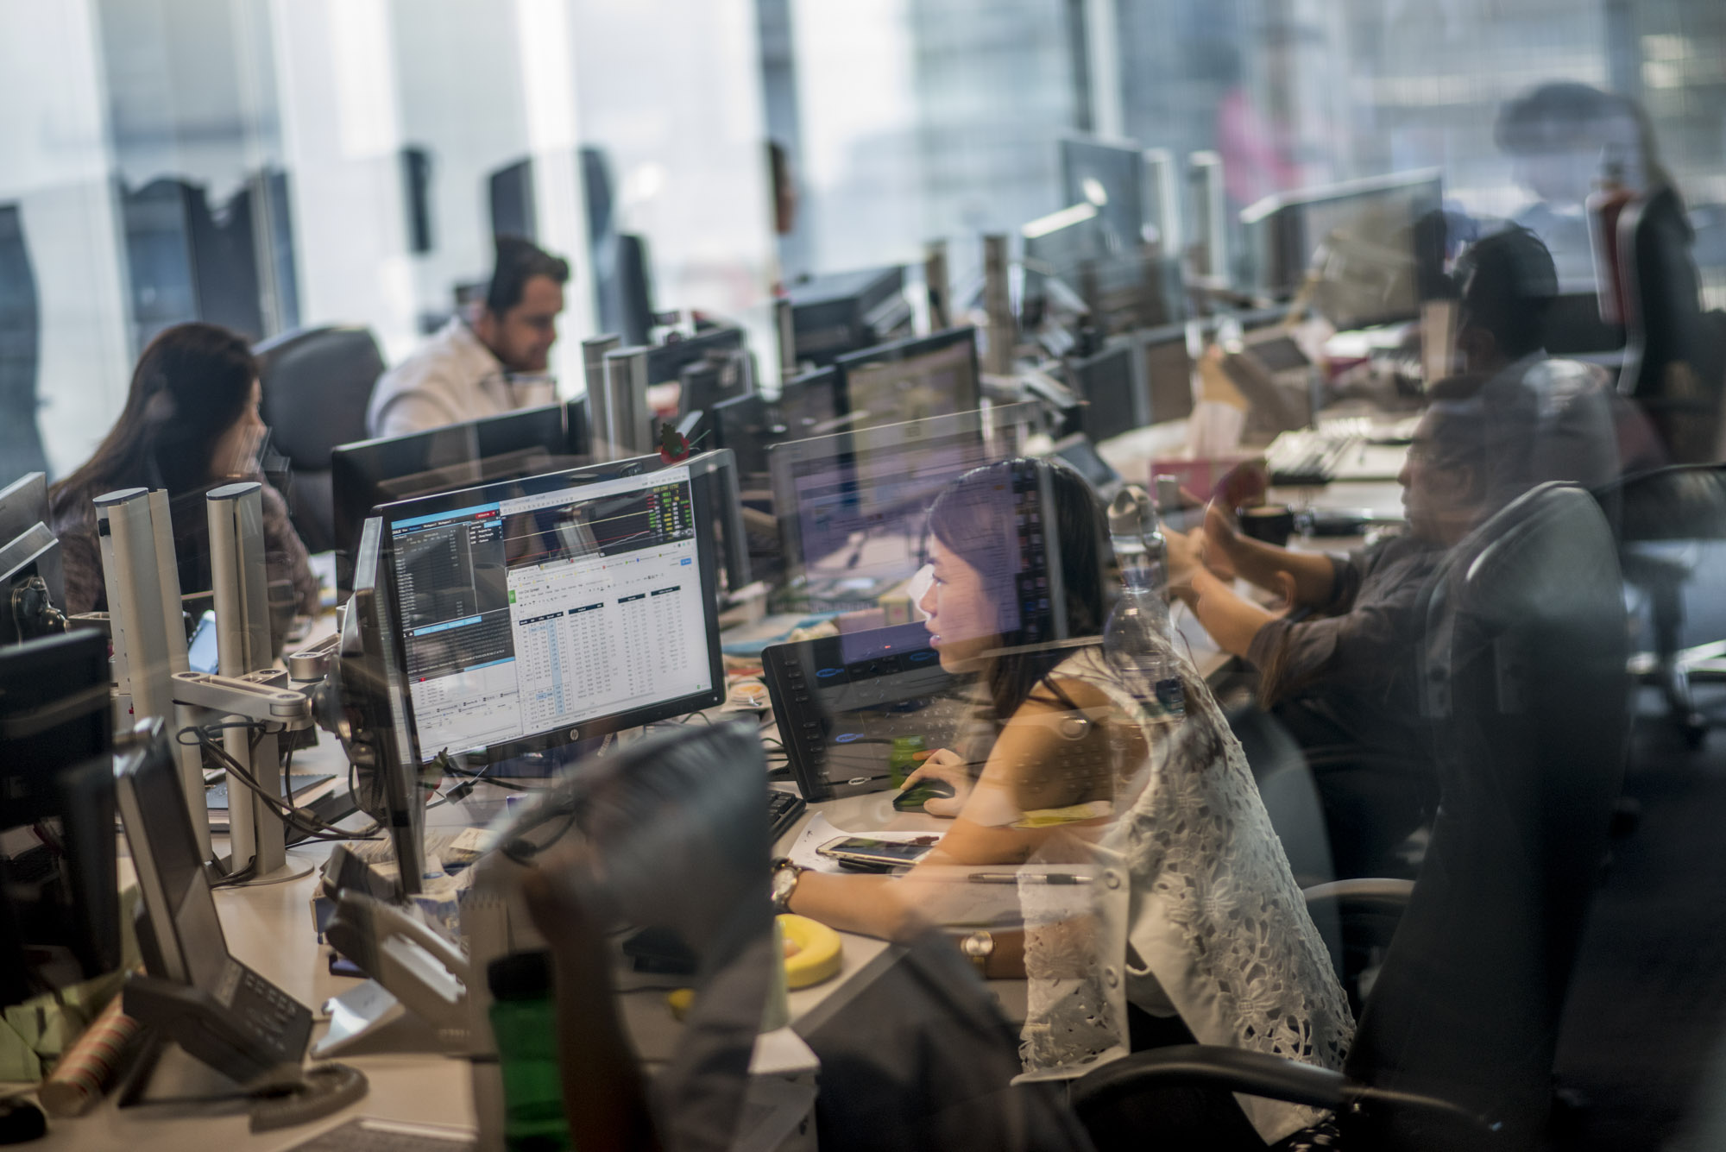




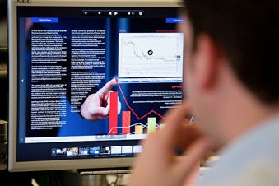
Introduction of Clarksons PLC
169 Years
23 countries
Corporate governance
54 offices
Operations
Strategies
1600 employees worldwide
Notes:
169 years
54 offices
23 countries (UK, USA, Egypt, Greece, South Africa, Italy, Switzerland, Germany, India, Australia, China, Japan and ……..)
1600 employees worldwide
Offices & Services: Broking, Financial, Supports, Research
Strategies(Breath, Reach, Understanding, People, Trust, Growth)
Corporate governance -page (90)- 2020
Clarksons PLC., 2021. about us. [online] Available at: <https://www.clarksons.com/about-us/> [Accessed 20 November 2021].
Clarksons PLC., 2020. Annual Report 2020 [online] Available at : <https://www.clarksons.com/media/1244445/annual_report_2020.pdf> [Accessed 27 November 2021].
Clarksons PLC., 2021. Clarksons PLC can designs. [image online] Available at:<https://www.clarksons.com/about-us> [Accessed 27 November 2021].

Slide 2
Discuss on current D/E Ratio(2020) and the Possible Reasons
Notes:
The debt-to-equity (D/E) ratio is used to evaluate a company's financial leverage and is calculated by dividing a company’s total liabilities by its shareholder equity. The D/E ratio is an important metric used in corporate finance. It is a measure of the degree to which a company is financing its operations through debt versus wholly owned funds. More specifically, it reflects the ability of shareholder equity to cover all outstanding debts in the event of a business downturn. The debt-to-equity ratio is a particular type of gearing ratio.
Modifications to the Debt-to-Equity (D/E) Ratio
The shareholders' equity portion of the balance sheet is equal to the total value of assets minus liabilities, but that isn’t the same thing as assets minus the debt associated with those assets. A common approach to resolving this issue is to modify the D/E ratio into the long-term D/E ratio. An approach like this helps an analyst focus on important risks
Short-term debt is still part of the overall leverage of a company, but because these liabilities will be paid in a year or less, they aren’t as risky
Investopedia, 2021. CORPORATE FINANCE & ACCOUNTING FINANCIAL RATIOS Debt to Equity Ratio . [online] Available at: <https://www.investopedia.com/terms/d/debtequityratio.asp> [Accessed 30 November 2021].
Clarksons PLC, 2021. Investors - Five Year Financial Summary Clarksons. [online] Available at: <https://www.clarksons.com/investors/five-year-financial-summary/> [Accessed: 20 November 2021].
Appendix A

Slide 3
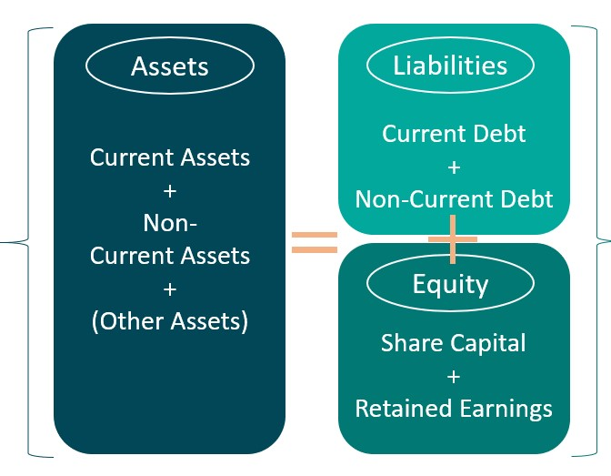
Discuss on current D/E Ratio and the Possible Reasons
D/E Ratio= Total Debt/Total Equity
1-Increase in Liabilities
current Liabilities
2-Decrease in Assets
3-Decrease in Equity
decrease in Retained earnings (increase in Dividends payments)
non-current liabilities
decrease in Retained earnings (decrease in net income….)
Decrease in share Capital
Decrease in Current assets
Decrease in Non-current assets
Notes:
Merger-strategy., 2021. Merger-strategy can designs. [image online] Available at:<https://merger-strategy.com/balance-sheet-guide/> [Accessed 25 November 2021].

Slide 4
Evaluating the possible Reasons(Liabilities from 2018-2020)
Notes:
The result:
1- The results showed that total liabilities has increased and this increase is due to the increase in current liabilities and non-current liabilities from 2018 to 2019.
1-1) The increase in Current Liabilities is the result of an increase in Trade and other payables.
1-2) The increase in Non-Current Liabilities is the result of an increase in Lease liabilities.
(The 2018 information above is under IAS 17 ‘Leases’, whereby only leases classified as ‘finance leases’ were recognized as lease liabilities. On 1 January 2019, IFRS 16 ‘Leases’ came into effect, resulting in leases previously classified as operating under IAS 17 ‘Leases’ being recognized as a lease liability on the balance sheet. See note 2 for further details)
2- The results showed that total liabilities has increased and this increase is due to the increase in current liabilities from 2019 to 2020.
2-1) The increase in Current Liabilities is the result of an increase in Trade and other payables. (Accruals / tax and social security)
Included in accruals are bonuses which will be paid out subsequent to the year-end.
Trade payables and other payables are non-interest bearing and are normally settled on demand.
Clarkson, 2018. Investors - Five Year Financial Summary Clarksons. [online] Available at: <https://www.clarksons.com/investors/five-year-financial-summary/> [Accessed: 20 November 2021].
Clarkson., 2020. Annual Report 2020 [online] Available at : <https://www.clarksons.com/media/1244445/annual_report_2020.pdf> [Accessed 27 November 2021]
Clarkson., 2019. Annual Report 2019 [online] Available at : <https://www.clarksons.com/media/1224913/annual_report_2019.pdf> [Accessed 27 November 2021]
Appendix A

Slide 5
Evaluating the possible Reasons (Assets from 2018-2020)
Notes:
1- The results showed that total Assets decreased and this decline is due to the decline in non-current Assets. The current assets has increased.
2- The results showed that total Assets has decreased and this decline is due to the decline in non-current Assets from 2018 to 2020.
3- Property, plant and equipment and Investments have decreased slightly but Intangible assets has decresed significantly.
Clarkson., 2020. Annual Report 2020 [online] Available at : <https://www.clarksons.com/media/1244445/annual_report_2020.pdf> [Accessed 27 November 2021]
Clarkson., 2019. Annual Report 2019 [online] Available at : <https://www.clarksons.com/media/1224913/annual_report_2019.pdf> [Accessed 27 November 2021]
Appendix C

Slide 6
Evaluating the possible Reasons (Equity from 2018-2020)
Notes:
Other reserves:
Nature and purpose of other reserves:
ESOP reserve The ESOP reserve in the Group represents 2,228 shares (2018: 117,446 shares) held by the share purchase trusts to meet obligations under various incentive schemes. The shares are stated at cost. The market value of these shares at 31 December 2019 was £0.1m (2018: £2.2m). At 31 December 2019 none of these shares were under option (2018: none). During the year the share purchase trusts acquired 246,902 shares at a weighted average price of £24.08 (2018: 350,000 shares at £30.38), offset with shares utilized to settle employee incentives, see note 23 for further details of share incentive schemes. For the purposes of the cash flow statement, the above are netted within the movements in bonus accrual. Employee benefits reserve The employee benefits reserve is used to record the value of equity-settled share-based payments provided to employees. Details are included in note 23. Capital redemption reserve The capital redemption reserve arose on previous share buy-backs by Clarkson PLC. Hedging reserve This reserve comprises the effective portion of the fair value of cash flow hedging instruments relating to hedged transactions that have not yet occurred. Realized hedges are recycled to the statement of comprehensive income. Movements are net of tax. Further details on hedging are shown in note 28. Merger reserve This comprises the premium on the share placing in November 2014 and the shares issued in February 2015 as part of the Platou acquisition. No share premium is recorded in the financial statements, through the operation of the merger relief provisions of the Companies Act 2006. During the year, the Company impaired its investment in relation to the Platou acquisition. As a result, a corresponding transfer was made out of this reserve to the profit and loss account. The transfer from merger reserve is different from the impairment charge recognized in the group due to the relative carrying values recorded in the Group and Parent Company accounts. Currency translation reserve The currency translation reserve represents the currency translation differences arising from the consolidation of foreign operations.
Clarkson., 2020. Annual Report 2020 [online] Available at : <https://www.clarksons.com/media/1244445/annual_report_2020.pdf> [Accessed 27 November 2021]
Clarkson., 2019. Annual Report 2019 [online] Available at : <https://www.clarksons.com/media/1224913/annual_report_2019.pdf> [Accessed 27 November 2021]
Appendix C

Slide 7
How the Solvency Ratios have changed (2018-2020) Before and after the COVID-19 pandemic.
Notes:
A solvency ratio examines a firm's ability to meet its long-term debts and obligations.
The main solvency ratios include the debt-to-assets ratio, the interest coverage ratio, the equity ratio, and the debt-to-equity (D/E) ratio.
Solvency ratios are often used by prospective lenders when evaluating a company's creditworthiness as well as by potential bond investors.
Solvency ratios and liquidity ratios both measure a company's financial health but solvency ratios have a longer-term outlook than liquidity ratios.
Investopedia, 2021. CORPORATE FINANCE & ACCOUNTING FINANCIAL RATIOS Solvency Ratio . [online] Available at: <https://www.investopedia.com/terms/s/solvencyratio.asp> [Accessed 30 November 2021].
Equity Ratio
The shareholder equity ratio shows how much of a company's assets are funded by issuing stock rather than borrowing money.
The closer a firm's ratio result is to 100%, the more assets it has financed with stock rather than debt.
The ratio is an indicator of how financially stable the company may be in the long run
Investopedia, 2021. CORPORATE FINANCE & ACCOUNTING FINANCIAL RATIOS Debt to Equity Ratio . [online] Available at: <https://www.investopedia.com/terms/s/shareholderequityratio.asp> [Accessed 30 November 2021].
Debt Ratio:
A debt ratio measures the amount of leverage used by a company in terms of total debt to total assets.
This ratio varies widely across industries, such that capital-intensive businesses tend to have much higher debt ratios than others.
A company's debt ratio can be calculated by dividing total debt by total assets.
A debt ratio of greater than 1.0 or 100% means a company has more debt than assets while a debt ratio of less than 100% indicates that a company has more assets than debt.
Some sources consider the debt ratio to be total liabilities divided by total assets.
Investopedia, 2021. CORPORATE FINANCE & ACCOUNTING FINANCIAL RATIOS Debt Ratio. [online] Available at: <https://www.investopedia.com/terms/d/debtratio.asp> [Accessed 30 November 2021].
The result according to solvency ratios: increasing in debt to equity ratio, debt ratio shows that company's debt has increased in comparison with Equity and Assets during these 3 years from 2018 to 2020, and decreasing in Equity ratio shows that the company has financed much more of its assets using borrowed money rather than shareholder’s equity.
Clarkson, 2018. Investors - Five Year Financial Summary Clarksons. [online] Available at: <https://www.clarksons.com/investors/five-year-financial-summary/> [Accessed: 20 November 2021].
Clarkson., 2020. Annual Report 2020 [online] Available at : <https://www.clarksons.com/media/1244445/annual_report_2020.pdf> [Accessed 27 November 2021]
Clarkson., 2019. Annual Report 2019 [online] Available at : <https://www.clarksons.com/media/1224913/annual_report_2019.pdf> [Accessed 27 November 2021]
Appendix D

Slide 8
How the Liquidity Ratios have changed (2018-2020) before and after the COVID-19 pandemic.
Notes:
Liquidity ratios are an important class of financial metrics used to determine a debtor's ability to pay off current debt obligations without raising external capital.
Investopedia, 2021. CORPORATE FINANCE & ACCOUNTING FINANCIAL RATIOS Liquidity Ratio . [online] Available at: <https://www.investopedia.com/terms/l/liquidityratios.asp> [Accessed 30 November 2021].
The current ratio compares all of a company’s current assets to its current liabilities.
These are usually defined as assets that are cash or will be turned into cash in a year or less and liabilities that will be paid in a year or less.
The current ratio helps investors understand more about a company’s ability to cover its short-term debt with its current assets and make apples-to-apples comparisons with its competitors and peers.
Weaknesses of the current ratio include the difficulty of comparing the measure across industry groups, the overgeneralization of the specific asset and liability balances, and the lack of trending information.
Investopedia, 2021. CORPORATE FINANCE & ACCOUNTING FINANCIAL RATIOS current Ratio . [online] Available at: <https://www.investopedia.com/terms/c/currentratio.asp> [Accessed 30 November 2021].
The cash ratio: cash & cash equivalents to its current liabilities: is a liquidity measure that shows a company's ability to cover its short-term obligations using only cash and cash equivalents.
The cash ratio is derived by adding a company's total reserves of cash and near-cash securities and dividing that sum by its total current liabilities.
The cash ratio is more conservative than other liquidity ratios because it only considers a company's most liquid resources.
Investopedia, 2021. CORPORATE FINANCE & ACCOUNTING FINANCIAL RATIOS cash Ratio . [online] Available at: <https://www.investopedia.com/terms/c/cash-ratio.asp> [Accessed 30 November 2021].
The quick ratio measures a company's capacity to pay its current liabilities without needing to sell its inventory or obtain additional financing.
Investopedia, 2021. CORPORATE FINANCE & ACCOUNTING FINANCIAL RATIOS Quick Ratio . [online] Available at: <https://www.investopedia.com/terms/q/quickratio.asp> [Accessed 30 November 2021].
The operating cash flow ratio indicates if a company's normal operations are sufficient to cover its near-term obligations.
A higher ratio means that a company has generated more cash in a period than what was immediately needed to pay off current liabilities.
Cash flow from operations (CFO) is preferred over net income because there is less room to manipulate results through accounting tricks.
Investopedia, 2021. CORPORATE FINANCE & ACCOUNTING FINANCIAL RATIOS operation cash flow Ratio . [online] Available at: <https://www.investopedia.com/terms/o/ocfratio.asp> [Accessed 30 November 2021].
The result of liquidity ratios: Decreasing in current ratio from 2018 to 2019 shows that the company ability to cover short term debt with its current assets has decreased but from 2019 to 2020 there is not any significant changes and also there is a small increase in current ratio.
Regarding the cash ratio, it is clear the ability of the company to cover its short-term obligations using only cash and cash equivalents has decreased from 2018 to 2019 and also from 2019 to 2020.
According to the annual reports of 2019 and 2020 this decline from 2018 to 2019 is because of decreasing in investing and financing activities and also increasing in current Liabilities that explained it in previous slides and in 2020 is due to decreasing in cash flow from operating activities, investing (The Group held deposits totaling 22.8m (2019: 2.5m) with maturity periods greater than three months) and financing activities and also again because of increasing in current Liabilities .
Regarding the quick ratio the result shows the need for Clarksons to sell its inventory to pay its current liabilities during the Covid pandemic decreased as we can see an increase in quick ratio. The second point is that the current ratio and the quick ratio are similar.
Clarkson, 2018. Investors - Five Year Financial Summary Clarksons. [online] Available at: <https://www.clarksons.com/investors/five-year-financial-summary/> [Accessed: 20 November 2021].
Clarkson., 2020. Annual Report 2020 [online] Available at : <https://www.clarksons.com/media/1244445/annual_report_2020.pdf> [Accessed 27 November 2021]
Clarkson., 2019. Annual Report 2019 [online] Available at : <https://www.clarksons.com/media/1224913/annual_report_2019.pdf> [Accessed 27 November 2021]
Appendix D

Slide 9
How the Profitability Ratios has changed (2018-2020) before and after the COVID-19 pandemic.
Notes:
ROA= Return an assets
Return on assets (ROA) is an indicator of how well a company utilizes its assets in terms of profitability.
ROA is best used when comparing similar companies or by comparing a company to its own previous performance.
ROA does not take into account a company’s debt, while return on equity (ROE) does—if a company carries no debt, its shareholders' equity and its total assets will be the same and ROA would equal ROE.
Investopedia, 2021. CORPORATE FINANCE & ACCOUNTING FINANCIAL RATIOS Return on assets (ROA) . [online] Available at: <https://www.investopedia.com/terms/r/returnonassets.asp> [Accessed 30 November 2021].
ROE=
Return on equity (ROE) is calculated by dividing a company's net income by its shareholders' equity, thereby arriving at a measure of how efficient a company is in generating profits.
ROE can be distorted by a variety of factors, such as a company taking a large write-down or instituting a program of share buybacks.
Another drawback of using ROE to evaluate a stock is that it excludes a company's intangible assets—such as intellectual property and brand recognition—from the calculation.
While ROE can help investors identify a potentially profitable stock, it has its drawbacks and is not the only metric an investor should review when evaluating a stock.
Investopedia, 2021. FUNDAMENTAL ANALYSIS TOOLS FOR FUNDAMENTAL ANALYSIS Return on equity (ROE) . [online] Available at: <https://www.investopedia.com/articles/fundamental/03/100103.asp> [Accessed 30 November 2021].
Net profit Margin
Net profit margin measures how much net income is generated as a percentage of revenues received.
Net profit margin helps investors assess if a company's management is generating enough profit from its sales and whether operating costs and overhead costs are being contained.
Net profit margin is one of the most important indicators of a company's overall financial health.
Investopedia, 2021. CORPORATE FINANCE & ACCOUNTING FINANCIAL RATIOS net profit margin. [online] Available at: <https://www.investopedia.com/terms/n/net_margin.asp
> [Accessed 30 November 2021].
Appendix D

Slide 10
How the Revenue, EPS and Expenses have changed (2018-2020) before and after the COVID-19 pandemic.
Notes:
Clarkson, 2018. Investors - Five Year Financial Summary Clarksons. [online] Available at: <https://www.clarksons.com/investors/five-year-financial-summary/> [Accessed: 20 November 2021].
Clarkson., 2020. Annual Report 2020 [online] Available at : <https://www.clarksons.com/media/1244445/annual_report_2020.pdf> [Accessed 27 November 2021]
Clarkson., 2019. Annual Report 2019 [online] Available at : <https://www.clarksons.com/media/1224913/annual_report_2019.pdf> [Accessed 27 November 2021]
Appendix C

Slide 11
Notes:Covid-19
COVID-19 has clearly impacted all aspects of life and the economy. Despite the huge impact on shipping markets, Clarksons reported underlying profits before tax of ú44.7m exceeding market expectations. This is in no small part due to the commitment of management and the wider workforce who have stepped up to deliver those results in such unprecedented times. In terms of how we responded to COVID-19, the Company took no government loans, no staff were furloughed, all suppliers were paid in good time and the 2019 final dividend, while initially deferred, was paid in September 2020 as an interim dividend maintaining our 18-year progressive dividend policy. Though the recovery from the impact of the COVID-19 pandemic is still uncertain, we are confident that we shall return to payment of our dividends at the normal time in 2021 in respect of 2020 performance.
To enable the business to assess the impact of COVID-19, the 2019 final dividend was deferred from May 2020 and subsequently paid as an interim dividend in September 2020.
In light of COVID-19 and the resulting global macro-economic uncertainty, the Board keeps the carrying value of goodwill under constant review. The Board has considered and not identified any indication of impairment of these assets at 30 June 2021. However, in the event that any of the markets in which we operate has a sustained downturn, an impairment of the relevant CGU’s goodwill may be required. See note 14 on page 155 of the 2020 annual report for specific sensitivity disclosures, in particular in relation to the Offshore broking and Securities CGUs.

Slide 12
Appendix A
Liabilities analysis
Liabilities/year | 2018 | 2019 | 2020 | 2020 -30 June | 2021 -30 June
Current Liabilities | 143.6 | 170.6 | 177.4 | 137.9 | 141.3
Non-Current Liabilities | 21.3 | 68.2 | 66.9 | 70.3 | 63
Total | 164.9 | 238.8 | 244.3 | 208.2 | 204.3
Liabilities analysis
 | 2018 | 2019 | 2020 | 2020 -30 June | 2021 -30 June
Current Liabilities | 143.6 | 170.6 | 177.4 | 137.9 | 141.3
Non-Current Liabilities | 21.3 | 68.2 | 66.9 | 70.3 | 63
Total | 164.9 | 238.8 | 244.3 | 208.2 | 204.3
Current Liabilities analysis
 | 2018 | 2019 | 2020 | 2020 -30 June | 2021 -30 June
Interest-bearing loans and borrowings | 0 | 1.2 | 0 | 3.3 | 0
Trade and other payables | 135.4 | 151.3 | 160.6 | 117.1 | 126.1
Lease liabilities | 0 | 8.7 | 8.4 | 9.2 | 8.2
Income tax payable | 8 | 9.1 | 7.9 | 7.8 | 6.5
Provisions | 0.2 | 0.3 | 0.5 | 0.5 | 0.5
Total | 143.6 | 170.6 | 177.4 | 137.9 | 141.3
Equity analysis
 | 2018 | 2019 | 2020 | 2020 -30 June | 2021 -30 June
amount | 434.6 | 380.6 | 328.4 | 394.1 | 337.4
Total | 434.6 | 380.6 | 328.4 | 394.1 | 337.4
D/E ratio analysis
 | 2018 | 2019 | 2020 | 2020 -30 June | 2021 -30 June
Total percent | 37.94% | 62.74% | 74.39% | 52.83% | 60.55%
Non-current Liabilities analysis
 | 2018 | 2019 | 2020 | 2020 -30 June | 2021 -30 June
Interest-bearing loans and borrowings | 0 | 0.1 | 0.1 | 6.1 | 0
Trade and other payables | 10.5 | 2.4 | 2.7 | 3.1 | 3
Lease liabilities | 0 | 53.7 | 47.7 | 52 | 42.6
Provisions | 0.2 | 1.5 | 1.5 | 1.5 | 1.6
Employee benefits | 4.2 | 4.5 | 6.1 | 6.4 | 3.8
Deferred tax liabilities | 6.4 | 6 | 8.8 | 7.2 | 12
Total | 21.3 | 68.2 | 66.9 | 76.3 | 63
Modified D/E ratio analysis
 | 2018 | 2019 | 2020 | 2020 -30 June | 2021 -30 June
Total percent | 4.90% | 17.92% | 20.37% | 17.84% | 18.67%

Slide 13
Appendix C
Total Assets
 | 2018 | 2019 | 2020 | 2020 -30 June | 2021 -30 June
non-current assets | 354.3 | 349.9 | 290.1 | 351.3 | 287.4
current assets | 245.2 | 269.5 | 282.6 | 251 | 254.3
Total | 599.5 | 619.4 | 572.7 | 602.3 | 541.7
Equity analysis
 | 2018 | 2019 | 2020 | 2020 -30 June | 2021 -30 June
Share capital | 7.6 | 7.6 | 7.6 | 7.6 | 7.6
Other reserves | 237.1 | 158.4 | 104.6 | 157.8 | 104
Retained earnings | 185.9 | 211.5 | 211.9 | 226.9 | 222
Non-controlling interests | 4 | 3.1 | 4.3 | 1.8 | 3.8
Total | 434.6 | 380.6 | 328.4 | 394.1 | 337.4
Current assets
 | 2018 | 2019 | 2020 | 2020 -30 June | 2021 -30 June
Inventories | 0.8 | 1.1 | 1.3 | 1.3 | 1.4
Trade and other receivables | 77 | 77 | 76.6 | 76.1 | 95.2
Income tax receivable | 1.2 | 0.1 | 0.2 | 0.3 | 0.8
Investments | 9.7 | 15.6 | 31.1 | 14.4 | 4
Cash and cash equivalents | 156.5 | 175.7 | 173.4 | 158.9 | 152.9
Total | 245.2 | 269.5 | 282.6 | 251 | 254.3
Revenue analysis
 | 2018 | 2019 | 2020 | 2020 -30 June | 2021 -30 June
Broking | 251.7 | 283 | 282.6 | 147.1 | 142.7
Financial | 46.1 | 35.5 | 33.9 | 13.3 | 24.7
Support | 23.9 | 27.7 | 24.9 | 11.5 | 14.1
Research | 15.9 | 16.8 | 16.8 | 8.5 | 8.6
Total | 337.6 | 363 | 358.2 | 180.4 | 190.1
EPS analysis
 | 2018 | 2019 | 2020 | 2020 -30 June | 2021 -30 June
Total | 105.2 | 118.8 | 106
Non- current assets analysis
 | 2018 | 2019 | 2020 | 2020 -30 June | 2021 -30 June
Property, plant and equipment | 27 | 25.6 | 24.3 | 25.4 | 23.1
Investment properties | 1.2 | 1.2 | 1.2 | 1.2 | 1.1
Right-of-use assets | 0 | 53.4 | 47 | 52.5 | 42.5
Intangible assets | 293.4 | 238.2 | 182.9 | 238.4 | 182.8
Trade and other receivables | 1.1 | 2.1 | 3.1 | 2.1 | 2.5
Investments | 4.8 | 4.8 | 2.9 | 4.7 | 1.3
Employee benefits | 18.2 | 15.5 | 18.1 | 18.4 | 24.7
Deferred tax assets | 8.6 | 9.1 | 10.6 | 8.6 | 9.4
Total | 354.3 | 349.9 | 290.1 | 351.3 | 287.4

Slide 14
Appendix D
Debt to Equity ratio analysis
 | 2018 | 2019 | 2020 | 2020 -30 June | 2021 -30 June
Total percent | 37.94% | 62.74% | 74.39% | 52.83% | 60.55%
Equity ratio analysis
 | 2018 | 2019 | 2020 | 2020 -30 June | 2021 -30 June
Total percent | 72.49% | 61.45% | 57.34% | 65.43% | 62.29%
Debt ratio analysis
 | 2018 | 2019 | 2020 | 2020 -30 June | 2021 -30 June
Total percent | 27.51% | 38.55% | 42.66% | 34.57% | 37.71%
operating cash flow ratio analysis
 | 2018 | 2019 | 2020 | 2020 -30 June | 2021 -30 June
Total | 0.22 | 0.45 | 0.43 | -0.02 | -0.09
Cash ratio analysis
 | 2018 | 2019 | 2020 | 2020 -30 June | 2021 -30 June
Total | 1.09 | 1.03 | 0.98 | 1.15 | 1.08
ROA analysis
 | 2018 | 2019 | 2020 | 2020 -30 June | 2021 -30 June
Total | 0.06 | 0.06 | 0.06 | 0.00 | 0.00
ROE analysis
 | 2018 | 2019 | 2020 | 2020 -30 June | 2021 -30 June
Total | 0.08 | 0.10 | 0.11 | 0.00 | 0.00
Net profit margin analysis
 | 2018 | 2019 | 2020 | 2020 -30 June | 2021 -30 June
Total | 10.25 | 10.44 | 9.83 | 0.00 | 0.00
Current ratio analysis
 | 2018 | 2019 | 2020 | 2020 -30 June | 2021 -30 June
Total percent | 1.71 | 1.58 | 1.59 | 1.82 | 1.80
Quick ratio analysis
 | 2018 | 2019 | 2020 | 2020 -30 June | 2021 -30 June
Total percent | 1.70 | 1.57 | 1.59 | #DIV/0! | 1.79

Slide 15
Appendix -Formula
D/E Ratio= Total Debt/Total Equity
Modified D/E Ratio= Total long term Debt/Total Equity
Total Liabilities: Current Liabilities + Non-Current Liabilities
Total Assets: non-current assets+current assets
Equity Ratio: Total Shareholders Equity/Total Assets
Debt Ratio: Total Debt/Total Assets
Current Ratio: Current assets/Current liabilities
Operating cash flow ratio: operating cash flow/current liabilities
Cash Ratio= Cash & cash equivalent/Current liabilities
ROA=Net Income/Total assets
ROE= Net Income/ Total Shareholders Equity
Net profit margin=(Net income/Revenue)*100

Slide 16
References
Clarksons PLC, 2021. about us. [online] Available at: <https://www.clarksons.com/about-us/> [Accessed 20 November 2021].
Clarksons PLC, 2021. Investors - Five Year Financial Summary Clarksons. [online] Available at: <https://www.clarksons.com/investors/five-year-financial-summary/> [Accessed 20 November 2021].
Clarkson., 2020. Annual Report 2020 [online] Available at : <https://www.clarksons.com/media/1244445/annual_report_2020.pdf> [Accessed 27 November 2021]
Clarkson., 2019. Annual Report 2019 [online] Available at : <https://www.clarksons.com/media/1224913/annual_report_2019.pdf> [Accessed 27 November 2021]
Clarksons PLC., 2021. Clarksons PLC can designs. [image online] Available at:<https://www.clarksons.com/about-us> [Accessed 27 November 2021].
Merger-strategy., 2021. Merger-strategy can designs. [image online] Available at:<https://merger-strategy.com/balance-sheet-guide/> [Accessed 25 November 2021].
Investopedia, 2021. CORPORATE FINANCE & ACCOUNTING FINANCIAL RATIOS Solvency Ratio . [online] Available at: <https://www.investopedia.com/terms/s/solvencyratio.asp> [Accessed 30 November 2021].
0210809_-_ckn_interim_results_2021 UNAUDITED (1).pd

Slide 17
References
Investopedia, 2021. CORPORATE FINANCE & ACCOUNTING FINANCIAL RATIOS Debt to Equity Ratio . [online] Available at: <https://www.investopedia.com/terms/s/shareholderequityratio.asp> [Accessed 30 November 2021].
Investopedia, 2021. CORPORATE FINANCE & ACCOUNTING FINANCIAL RATIOS Debt to Equity Ratio . [online] Available at: <https://www.investopedia.com/terms/d/debtequityratio.asp> [Accessed 30 November 2021].
Investopedia, 2021. CORPORATE FINANCE & ACCOUNTING FINANCIAL RATIOS Debt Ratio. [online] Available at: <https://www.investopedia.com/terms/d/debtratio.asp> [Accessed 30 November 2021].
Investopedia, 2021. CORPORATE FINANCE & ACCOUNTING FINANCIAL RATIOS Liquidity Ratio . [online] Available at: <https://www.investopedia.com/terms/l/liquidityratios.asp> [Accessed 30 November 2021].
Investopedia, 2021. CORPORATE FINANCE & ACCOUNTING FINANCIAL RATIOS current Ratio . [online] Available at: <https://www.investopedia.com/terms/c/currentratio.asp> [Accessed 30 November 2021].
Investopedia, 2021. CORPORATE FINANCE & ACCOUNTING FINANCIAL RATIOS cash Ratio . [online] Available at: <https://www.investopedia.com/terms/c/cash-ratio.asp> [Accessed 30 November 2021].
Investopedia, 2021. CORPORATE FINANCE & ACCOUNTING FINANCIAL RATIOS operation cash flow Ratio . [online] Available at: <https://www.investopedia.com/terms/o/ocfratio.asp> [Accessed 30 November 2021].

Slide 18
References
Investopedia, 2021. CORPORATE FINANCE & ACCOUNTING FINANCIAL RATIOS Return on assets (ROA) . [online] Available at: <https://www.investopedia.com/terms/r/returnonassets.asp> [Accessed 30 November 2021].
Investopedia, 2021. FUNDAMENTAL ANALYSIS TOOLS FOR FUNDAMENTAL ANALYSIS Return on equity (ROE) . [online] Available at: <https://www.investopedia.com/articles/fundamental/03/100103.asp> [Accessed 30 November 2021].
Investopedia, 2021. CORPORATE FINANCE & ACCOUNTING FINANCIAL RATIOS Quick Ratio . [online] Available at: <https://www.investopedia.com/terms/q/quickratio.asp> [Accessed 30 November 2021].
Investopedia, 2021. CORPORATE FINANCE & ACCOUNTING FINANCIAL RATIOS net profit margin. [online] Available at: <https://www.investopedia.com/terms/n/net_margin.asp> [Accessed 30 November 2021].

